Slide 1
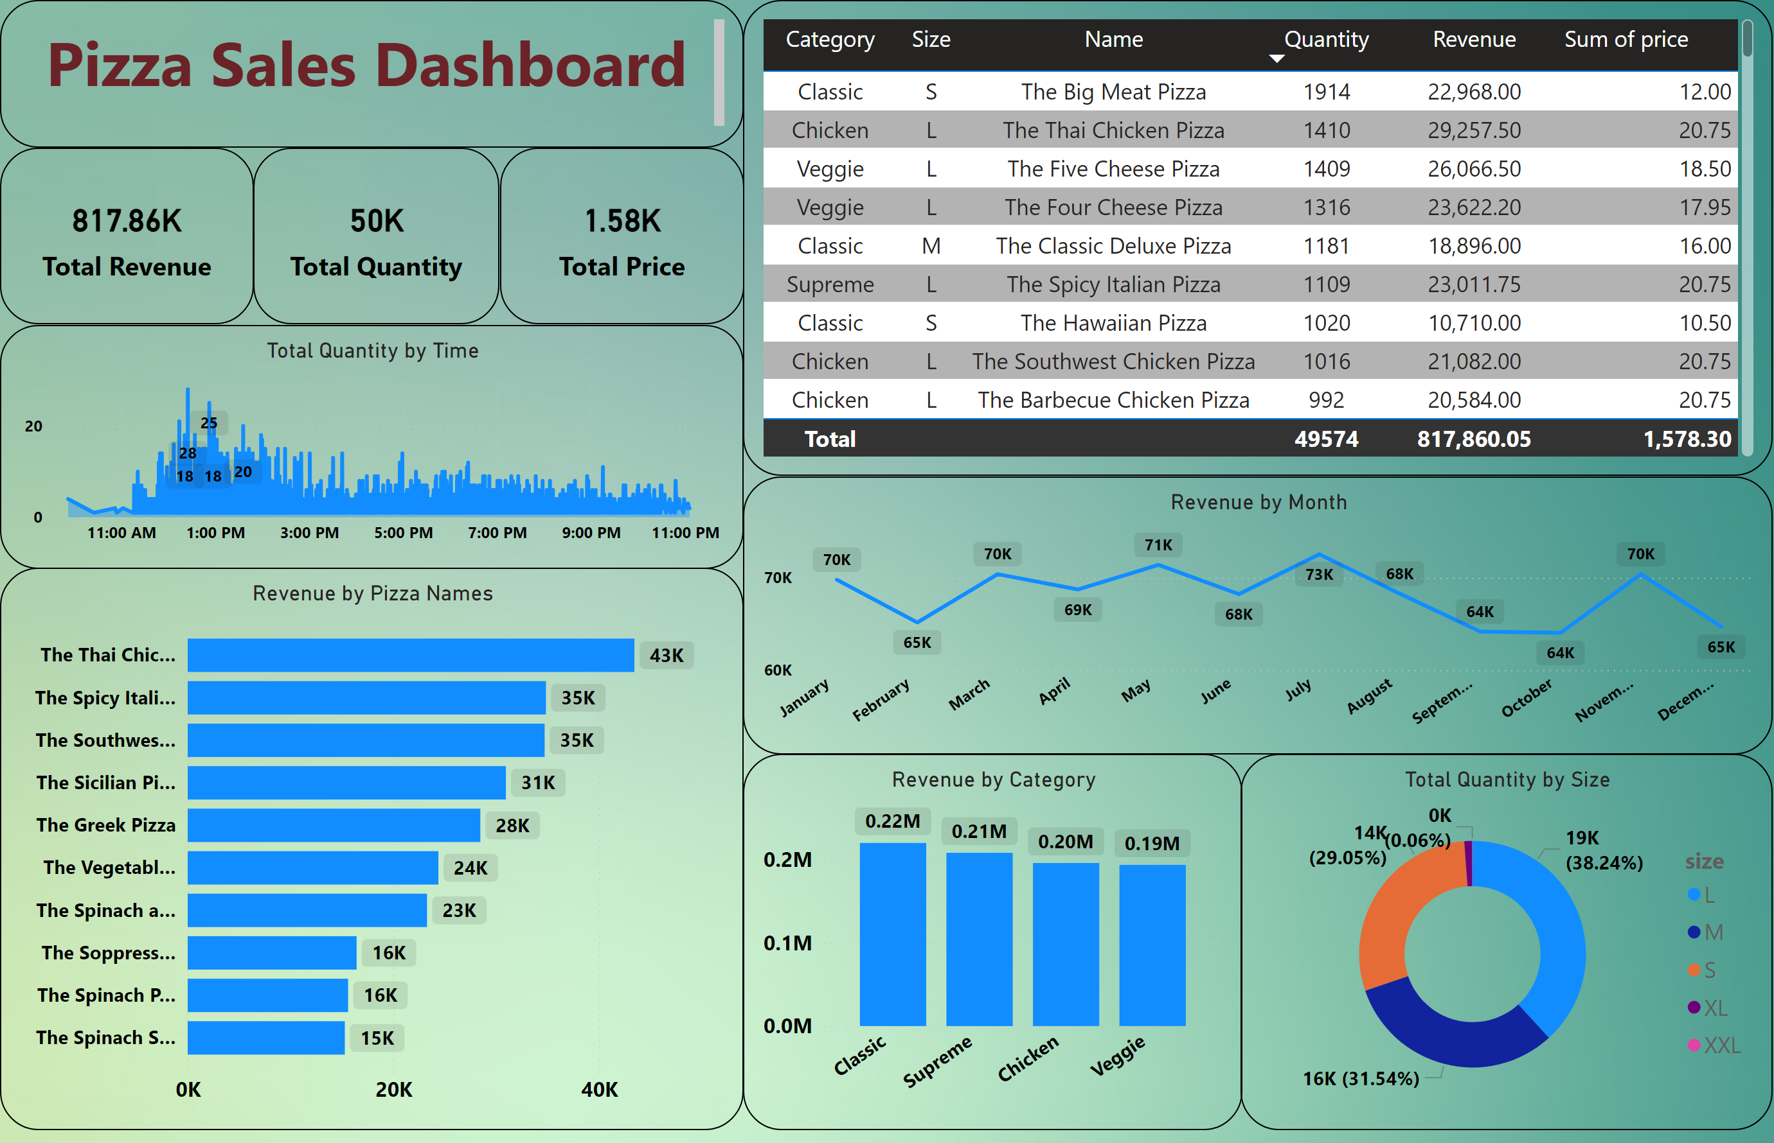
Dashboard
Notes:
card
No alt text provided
card
No alt text provided
Revenue by Category
No alt text provided
Revenue by Pizza Names
No alt text provided
Revenue by Month
No alt text provided
Total Quantity by Size
No alt text provided
stackedAreaChart
No alt text provided
tableEx
No alt text provided
card
No alt text provided
textbox
No alt text provided

